Slide 1



Traffic Sign Recognition Project
Team 4 Seojeong Kim · Minjun Park · Hyunwoo Song · Eungyu Park

Slide 2
Project goal &
Core Research Question
Project Goal
Build a CNN-based traffic sign classifier using GTSRB, then evaluate how well the learned visual features transfer to real-road crops and synthetic sign images.
Input: traffic sign image or cropped sign region
Output: one of 43 classes + confidence score
Models: custom CNN baseline + EfficientNet-B0 transfer learning

Slide 3
Project goal &
Core Research Question
Core Research Question
If a model performs very well on clean cropped traffic signs, will it still work on real-road crops and synthetic environmental variations?
Why it matters: traffic sign recognition is useful only if the model is robust to lighting, resolution, crop quality, and camera conditions.
Clean cropped signs
GTSRB
Clean cropped signs
GTSRB
Synthetic signs
Synset

Slide 4
Dataset Explanation
GTSRB is the main dataset; GTSDB and Synset are used to test and improve generalization
Metric caution
GTSDB Full/reference accuracy includes some images that may have been used for domain adaptation, so it is not a pure unseen external-test score.
GTSRB
GTSDB
Synset Signset
Main Data set
Real-road adaptation / test
Synthetic-domain validation
51,839 images
476 crops
4,300 used
43 classes
42 classes
43 of 211 classes
clean cropped sign
real-road scene
synthetic domain
Activity 2 baseline split
Class 32 absent; extreme imbalance
Use labels 0–42 only
33,328 train / 5,881 val / 12,630 test

Slide 5
Dataset Explanation
Why GTSRB fits the assignment requirements
Public dataset: Available online and suitable for course use
Labeled images: Each image has a ClassId traffic sign label
At least 20 classes: 43 classes, exceeding the requirement
Enough scale: 51,839 images support CNN training
Non trivial task: Similar signs, imbalance, small/blurred images
Application relevance
Traffic sign recognition is directly connected to driver assistance and autonomous driving. This makes the classification task meaningful beyond a toy dataset.

Slide 6
First Model Result
Strong Baseline, to General
The model successfully learned traffic-sign visual features. However, the validation-to-test gap suggests that generalization can still be improved through better augmentation, imbalance handling, or stronger architectures.
Metric
Value
Accuracy (%)
Accuracy
Train Loss
0.1708
100
Train Accuracy
93.83%
Validation Loss
0.1523
50
Validation Accuracy
94.90%
Test Loss
0.3483
Test Accuracy
89.46%
0
Train
Validation
Test

Slide 7
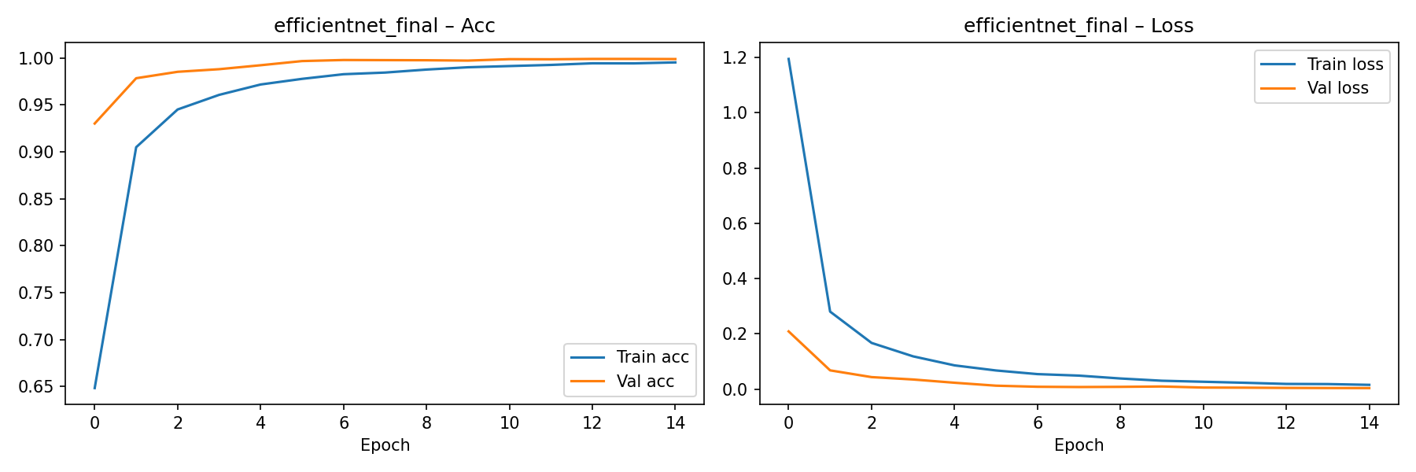
First Model Result
Strong Baseline, to General
The model successfully learned traffic-sign visual features. However, the validation-to-test gap suggests that generalization can still be improved through better augmentation, imbalance handling, or stronger architectures.

Slide 8
Final implementation
- Two models Used
Custom Baseline CNN
Implemented directly for the assignment baseline
Simple enough to interpret and debug
Provides a reference point for later improvements
Later code pipeline achieved 96.9% on GTSRB and 4.2% on GTSDB
EfficientNet-B0
ImageNet-pretrained weights
Final classifier changed to 43 traffic-sign classes
Full fine-tuning for the traffic-sign domain
Used for robust, mixed, final, and SynsetMix experiments

Slide 9
Final implementation
- Two models Used
Code Modules
config.py
dataset.py
models
train.py
evaluate.py
demo.py
The modular structure supports reproducibility: the same data loaders, training loop, and evaluation functions are reused across experiments.

Slide 10
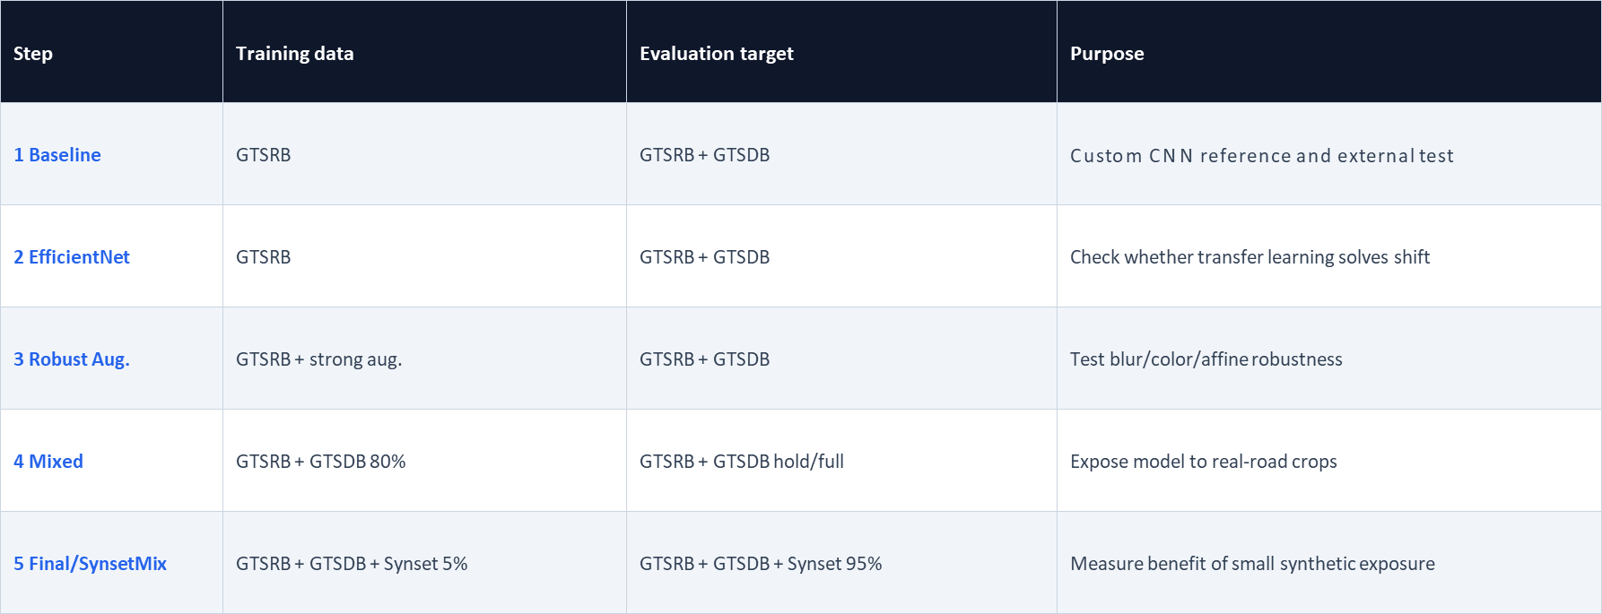
Experiment design

Slide 11
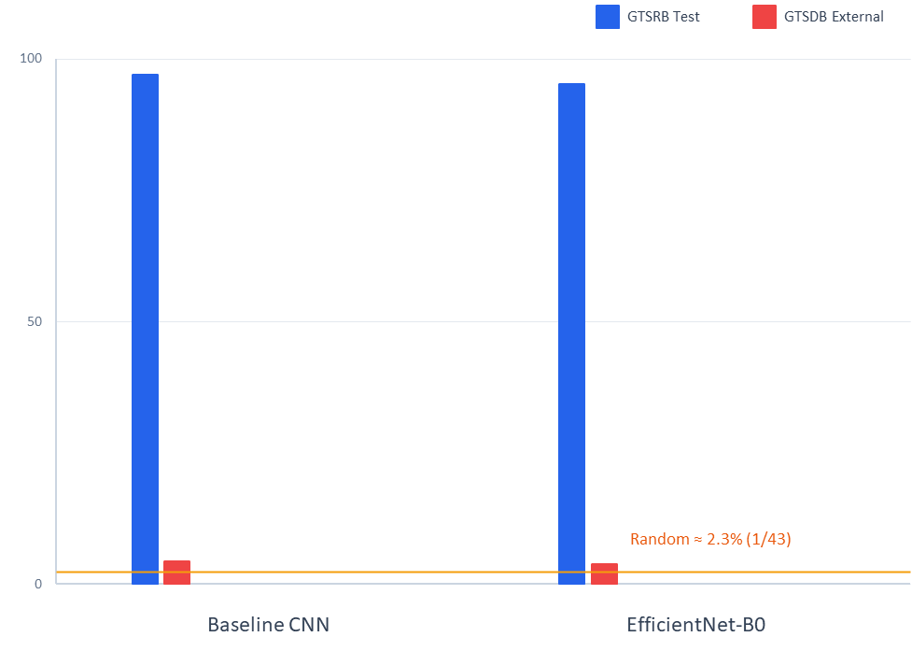
GTSRB Only Models
High in-domain accuracy, Poor external accuracy
A stronger architecture alone did not solve the real-road domain shift
Excellent accuracy on clean cropped signs does not guarantee real-road performance. The model learned useful traffic-sign features, but it also depended strongly on the GTSRB data distribution.

Slide 12
Why it was Difficult in GTSDB
The external dataset is tiny, imbalanced, and closer to real driving conditions
Many GTSDB crops are small, noisy, or affected by background and camera conditions. Upscaling very small signs to 48×48 can destroy visual detail.
GTSDB is originally closer to a detection benchmark. In this project, its bounding-box crops are used for classification evaluation and domain adaptation.
Total crops
476
Classes
42 / NO class 32
Average per class
11
Minimum
1: class 31, 37, 42
Maximum
49: class 2
Image size
23px ~ 121px

Slide 13
Improvement attempt 1
- Robust Augmentation
Stronger augmentation reduced GTSRB performance and did not improve GTSDB
Gaussian blur
Stronger color jitter
Larger affine translation/scale
More aggressive resize settings
The augmentation was too strong or mismatched to the actual GTSDB noise pattern. It damaged useful GTSRB features without giving the model the real-road distribution it needed.
EfficientNet GTSRB
95.2%
Robust GTSRB
87.0%
EfficientNet GTSDB
3.8%
Robust GTSDB
2.1%

Slide 14
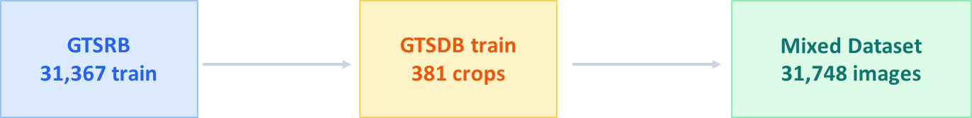
Improvement attempt 2
- GTSRB + GTSDB Mix
Direct exposure to real-road crops greatly improved GTSDB full/reference accuracy
GTSDB split details
476 crops total → 381 train mix + 95 hold-out. Classes with only one sample cannot be stratified, so they were assigned to the training-only side.
Why it helped
The model finally saw the target-domain crop style during training: small signs, imperfect crops, real-road lighting, and background noise.

Slide 15
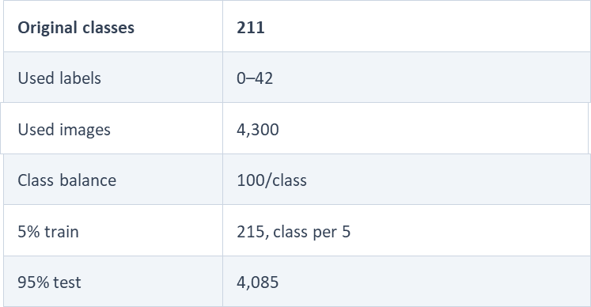
Synset Signset Germany
Only the labels that match GTSRB, 0–42, were used from the 211-class dataset
Role in the project
Synset provides synthetic rendering and imaging variations. By exposing the model to only 5% of Synset and testing on the remaining 95%, we measure whether a small amount of synthetic data can improve domain generalization.

Slide 16
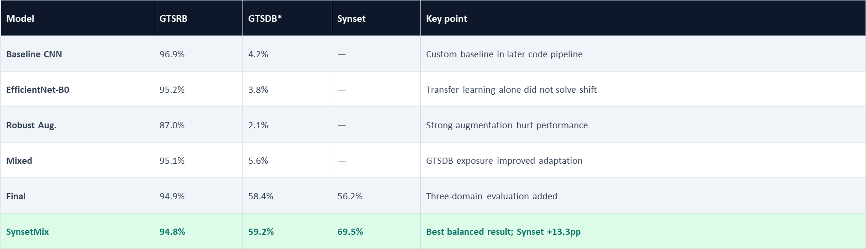
Results Summary
SynsetMix maintained GTSRB accuracy while improving GTSDB and Synset performance
EfficientNet GTSDB
Mixed GTSDB*
Final GTSDB*
SynsetMix GTSDB*
Final Synset
SynsetMix Synset

Slide 17
Why SynsetMix Worked
Mechanism
GTSRB teaches core traffic-sign shapes, colors, and symbols
GTSDB exposes the model to small real-road crops, imperfect lighting, and background noise
Synset 5% gives a small but useful sample of synthetic rendering artifacts
Training all domains together avoids overwriting one domain with another
Fine-tuning failure
Sequential Synset fine-tuning barely improved Synset accuracy but reduced GTSDB performance from 58.4% to 42.6%. This indicates catastrophic forgetting: the model adapted to one domain while losing useful features for another.

Slide 18
How to Interpret each Accuracy Correctly
GTSRB Test
Official in-domain test set. Measures whether the model learned the main GTSRB classification task.
GTSDB Hold-out
Unseen 20% of GTSDB after splitting. More honest for real-road generalization, but only about 95 images and unstable.
GTSDB Full / reference
All 476 GTSDB crops after some GTSDB data were used for adaptation. Useful for adaptation analysis, not pure external testing.
Synset 95%
After training with only 5% Synset, the remaining 95% tests synthetic-domain generalization.

Slide 19
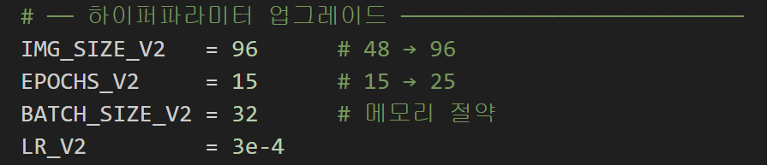
Evaluation
Resolution Enhancement
48X48 -> 96X96
Batch Size Change
64 -> 32

Slide 20
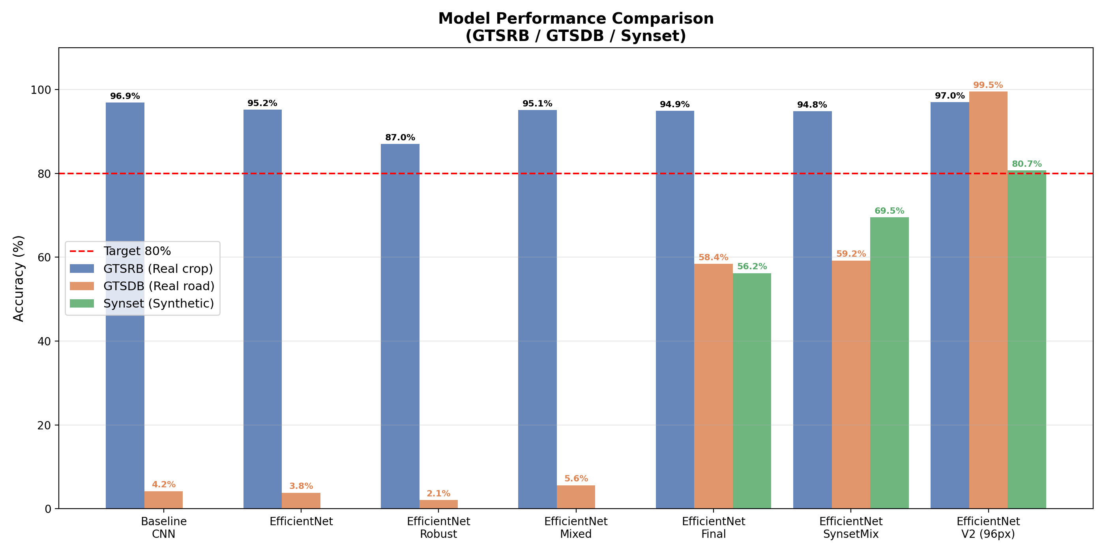
Final Results Summary

Slide 21
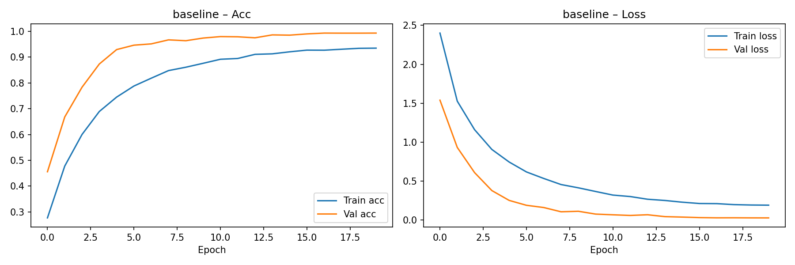
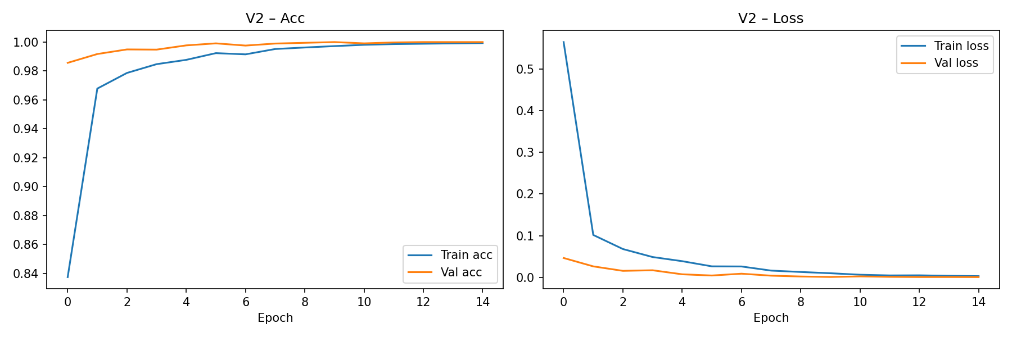
Final Results Summary

Slide 22
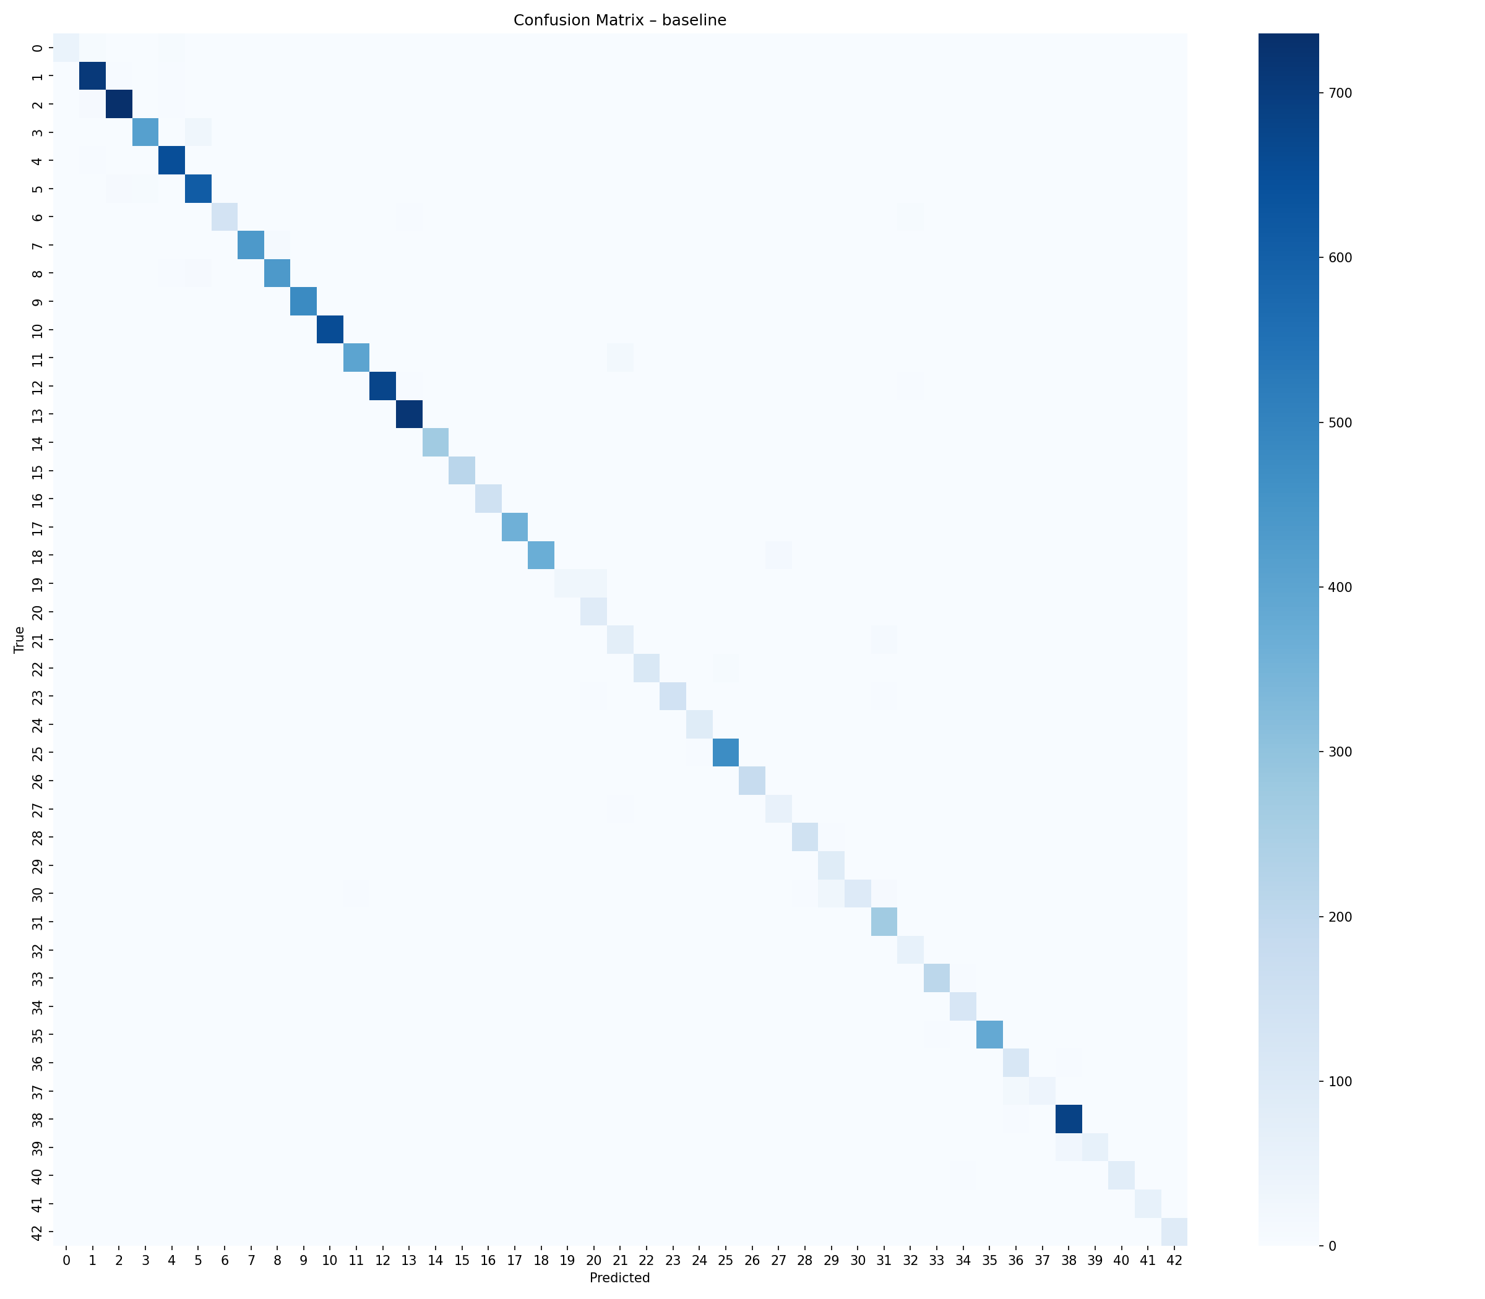
Final Results Summary

Slide 23
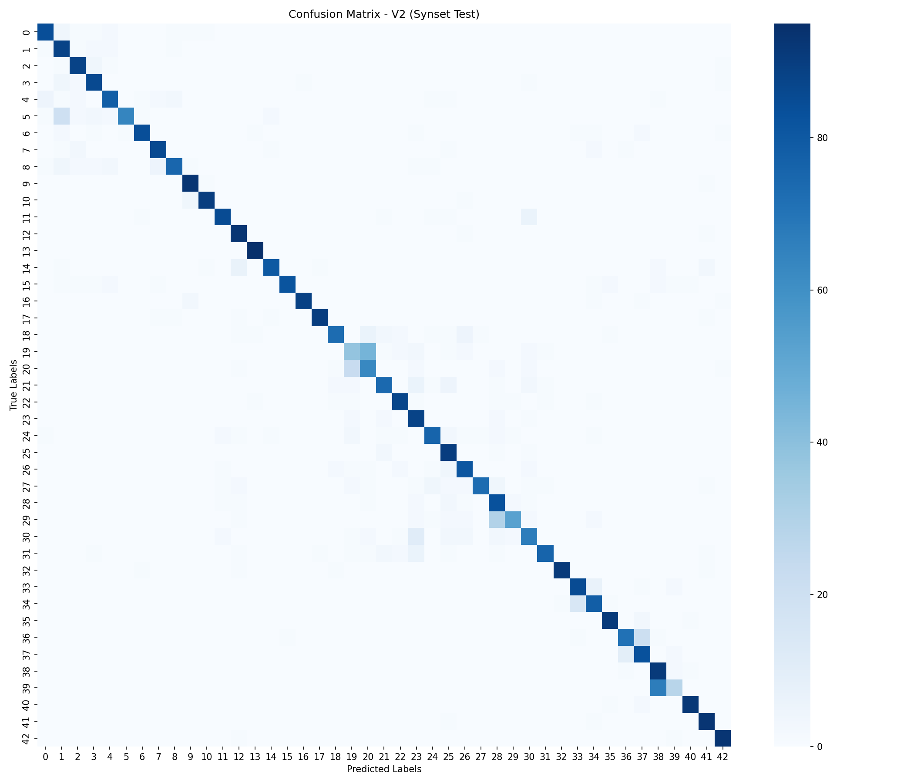
Final Results Summary

Slide 24
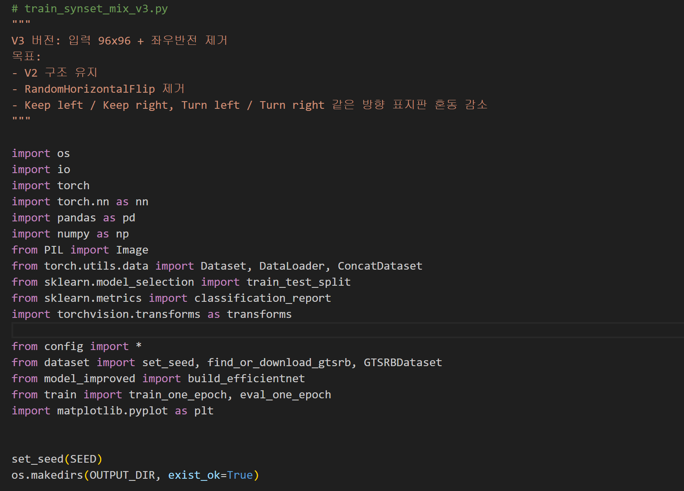
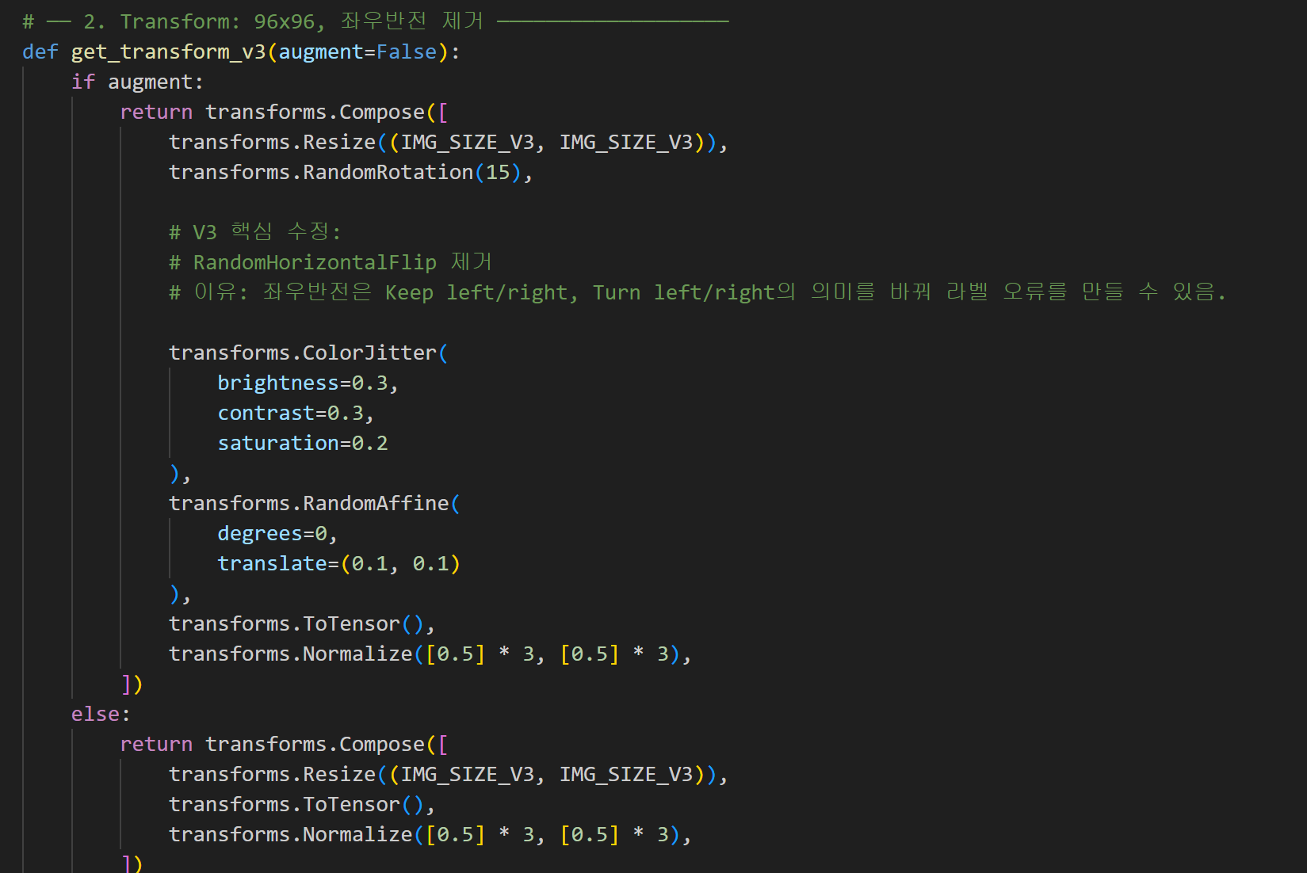
Evaluation – (2)
Removed horizontal flip
Reason: left/right traffic signs can be mislabeled by horizontal flipping
Expected effect: better preservation of visual details and semantic direction

Slide 25
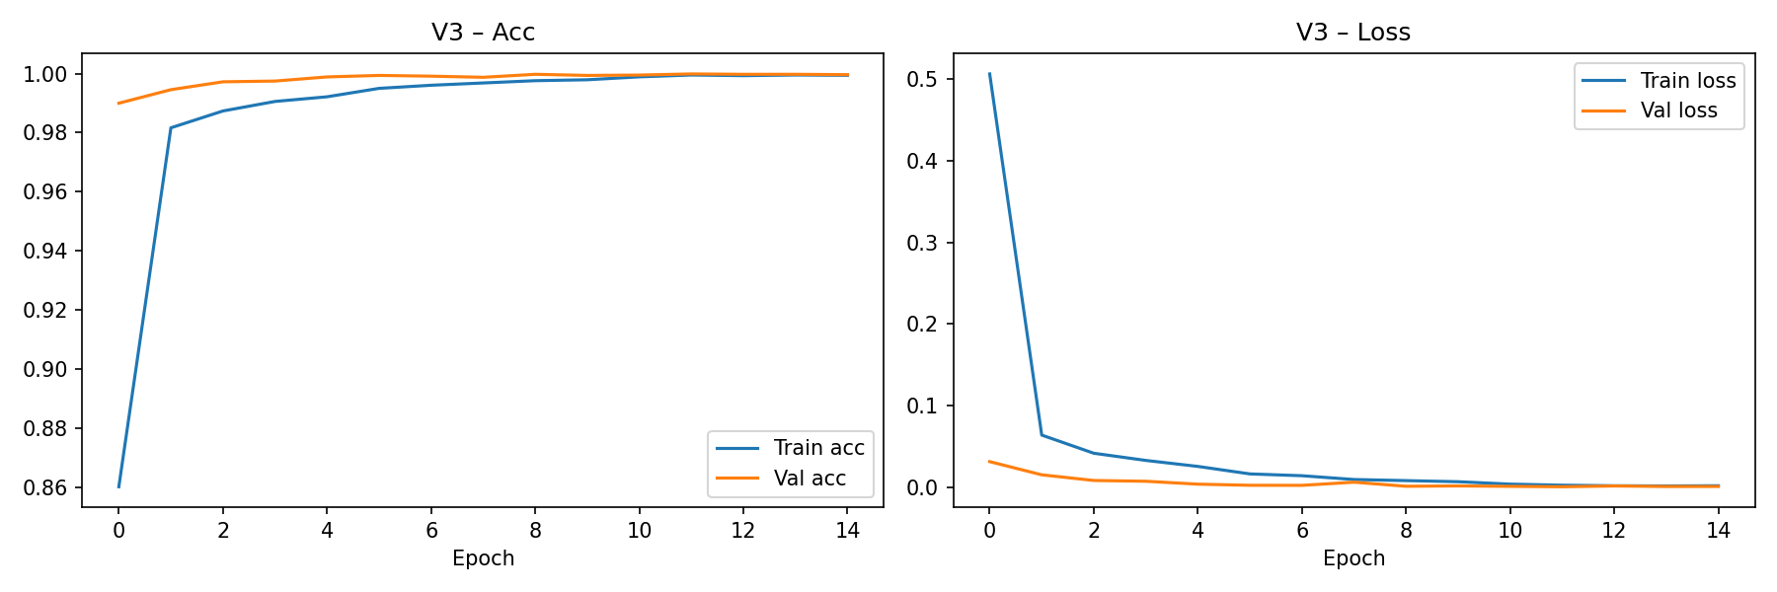
Evaluation (2) Results

Slide 26

Evaluation (2) Results

Slide 27
Evaluation &
Error Analysis
Evidence used for analysis
Training/validation loss curves
Training/validation accuracy curves
Confusion matrix
Failure-case visualization
Demo prediction examples
Main Interpretaiton
GTSRB-only models performed well on clean cropped signs but failed on GTSDB due to domain shift.
Small, blurry, and imperfectly cropped signs were the most difficult cases.
Mixed-domain training improved robustness by exposing the model to real-road and synthetic variations.

Slide 28
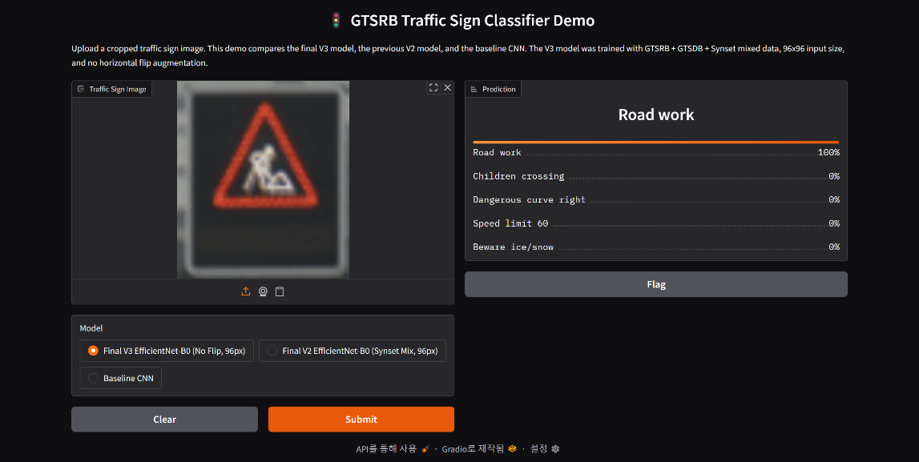
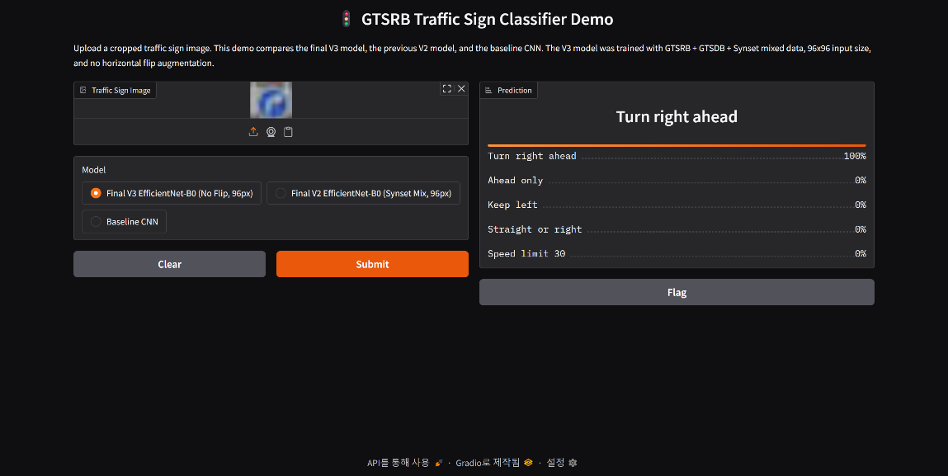
Final demo
https://8b0ad89f26c07eb609.gradio.live/

Slide 29
Conclusions &
Next Steps
The final model improved cross-domain robustness, but the evaluation should remain careful
GTSRB is a suitable dataset
It satisfies the assignment requirements and provides a meaningful 43-class traffic-sign classification task.
High GTSRB accuracy is not enough
GTSRB-only models dropped to nearly random performance on GTSDB due to domain shift.
Mixed training was most effective
Real-road and synthetic exposure improved robustness more reliably than stronger augmentation.
SynsetMix is the best final result
GTSRB 94.8%, GTSDB 59.2%*, and Synset 69.5% with only 5% Synset used for training.

